Slide 1
Foundation of computer science
By : Mohamed Agmai

Slide 2

Lecture 10
CPU part 1`

Slide 3
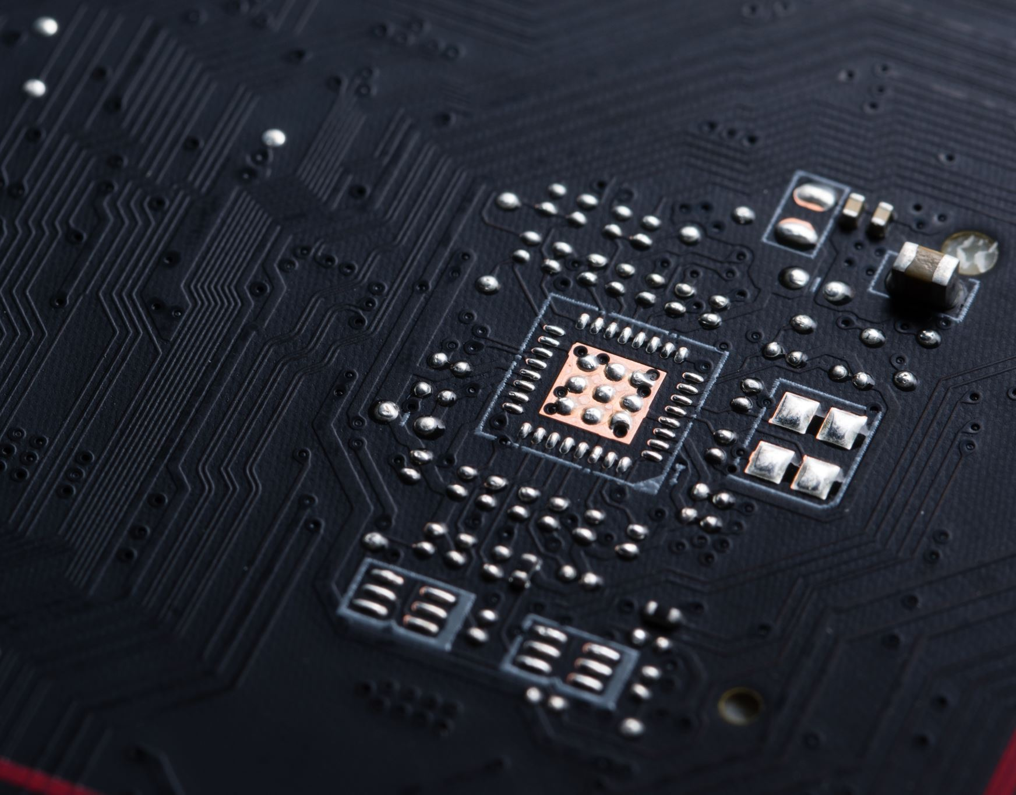

CPU (Central processor unit)

Slide 4
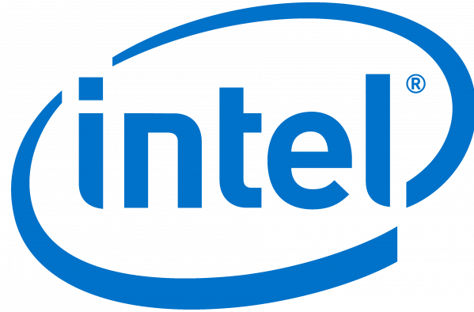

Processor types (manufacturer)

Slide 5
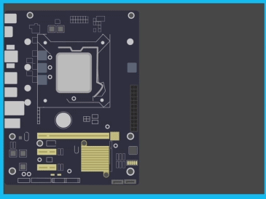
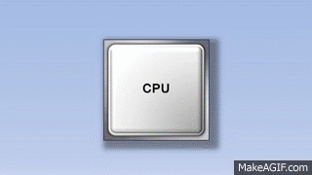

Slide 6
How does the processor work?

Slide 7
Register
Register
Front Side Bus
Internal memory cash
ALU
Arithmetic logic unit
ALU
Arithmetic logic unit
Front Side Bus
L2
L2
L1
Control Unit
1/ 0 Unit
Front Side Bus
RAM

Slide 8

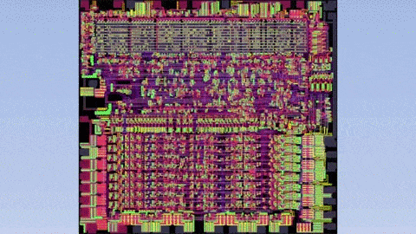
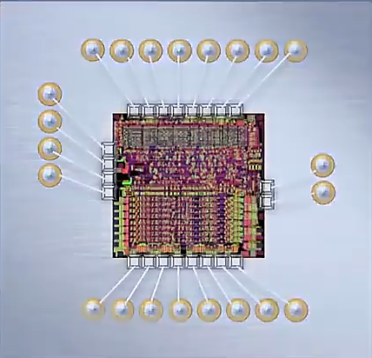
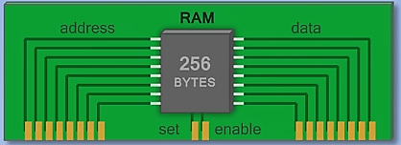
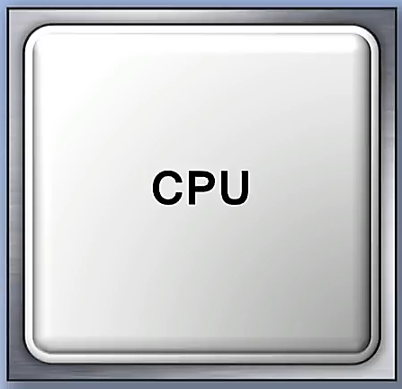
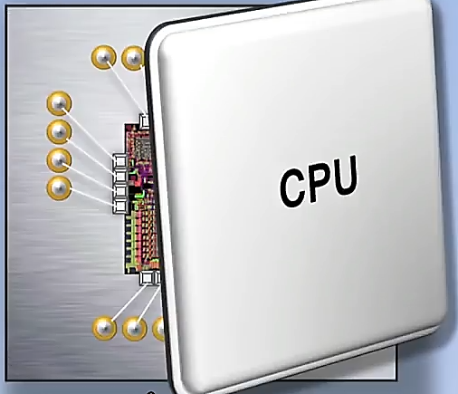
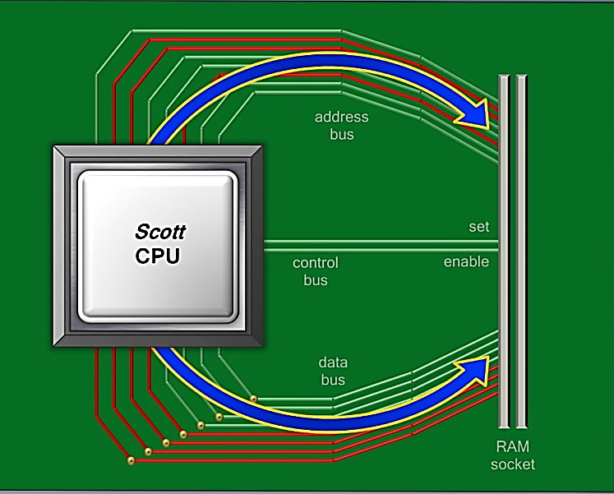
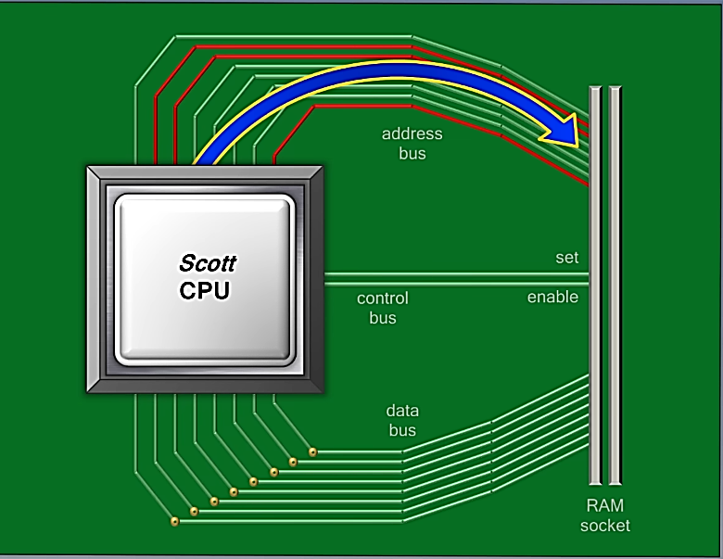
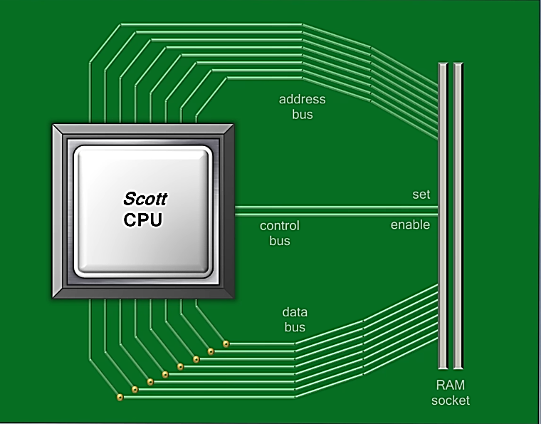
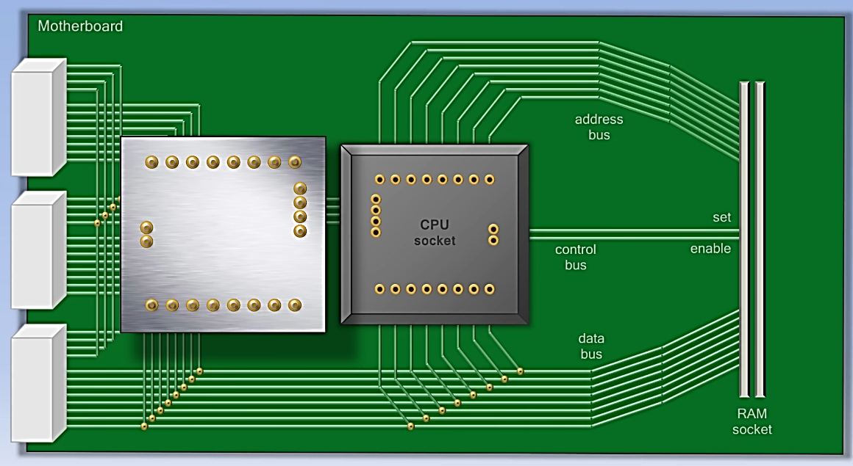
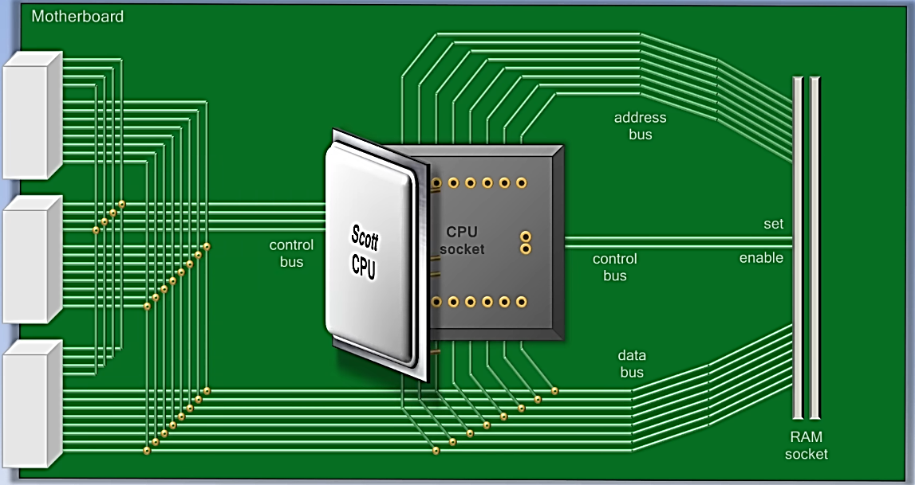
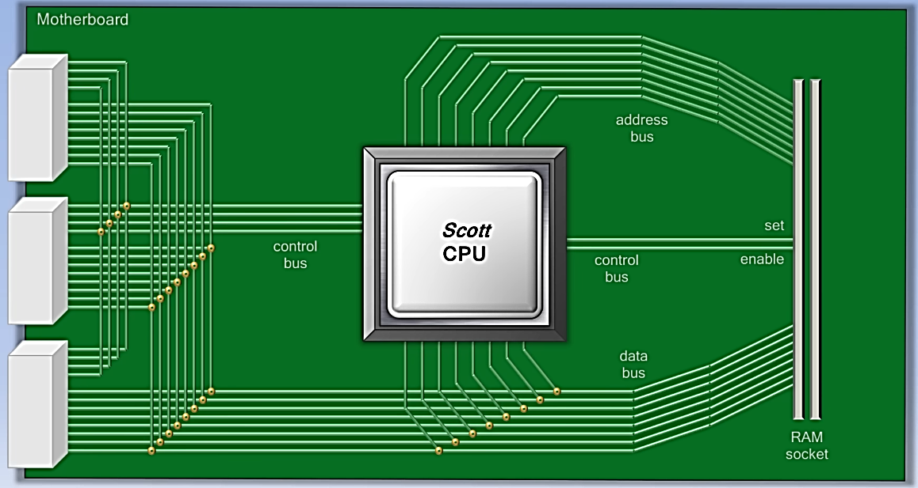
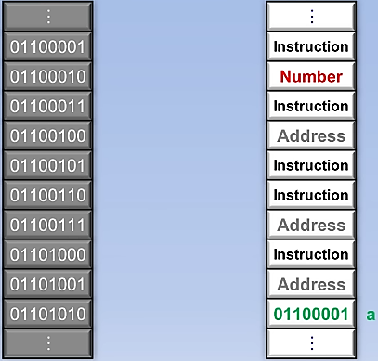
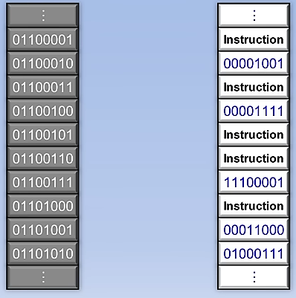
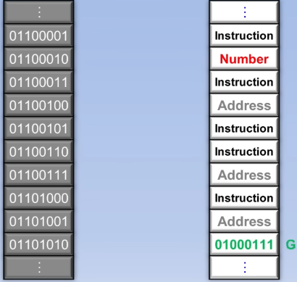
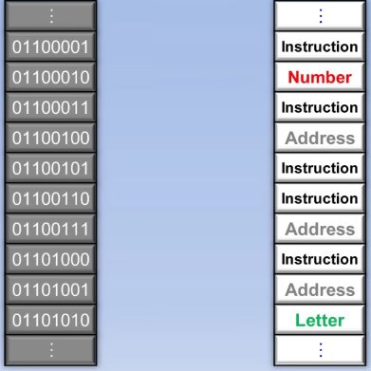
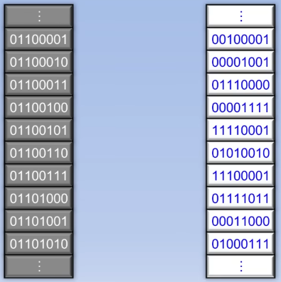


Clock

Slide 9
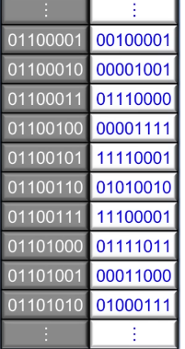
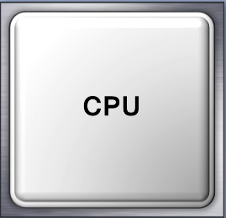
Insertions SET
lOAD
ADD
STORE
COMPARE
JUMP IF CONDITION
JUMP
OUT
IN

Slide 10



Important links

Slide 11
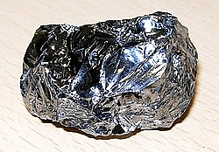
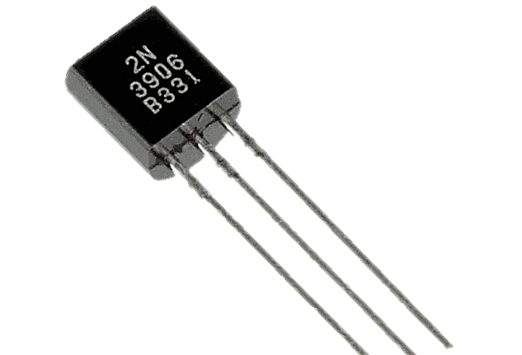
In 1947
A transistor is an electronic component used to control the flow of electric current. It functions as a switch or amplifier, allowing it to turn current on or off or amplify it. It is used in various applications such as digital circuits, audio amplifiers, and power control devices.

Slide 12
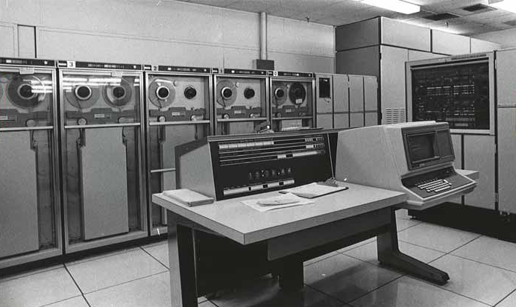
Second generation (1959-1965) - transistors
Technology: Vacuum tubes have been replaced by transistors, reducing size, cost, and power consumption, and increasing device reliability.
Programming became less risky and faster and began the development of high-level programming tools such as FORTRAN and COBOL.
Speed: Devices have become significantly faster compared to the first generation.
Examples:
IBM 1401: Its speed was approximately 1,400 calculations per second
IBM 7090 : Its speed was about 24,000 calculations per second.

Slide 13
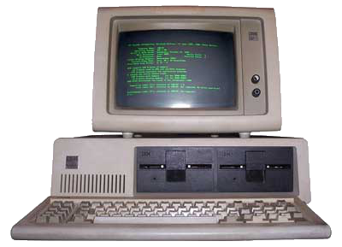
Third generation (1965-1971) - integrated circuits (ICs)
Technology: Integrated circuits were used instead of individual transistors, which allowed for increased density and dramatically reduced device size.
Impact: Computers became smaller, cheaper, and more powerful, and began to be used in businesses on a larger scale.
Programming: Programming languages ​​improved, and operating systems were developed, making computers easier to use.
Examples: IBM System/360
The system's processing speed ranged from 60,000 to 1,000,000 calculations per second.

Slide 14
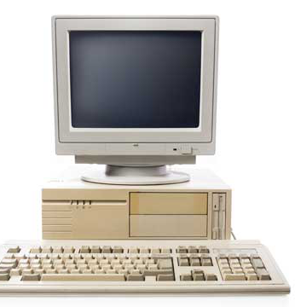
5. Fourth generation (1971-1980) - Microprocessors
Developments
Personal computers emerged with user-friendly graphical interfaces and mice.
They were affordably priced for home and office use.
Enabled internet communication.
Leading Companies:
Companies like Intel and AMD emerged.
Microsoft developed Windows and Apple introduced Macintosh.
Operating Mechanism:
Used VLSI technology with thousands of transistors.
CPU was placed on a silicon chip, forming a microprocessor.
RAM replaced magnetic memory, increasing speed.
Storage units became smaller and larger in capacity.
Programming Languages:
New languages like C, C++, and DBASE emerged

Slide 15
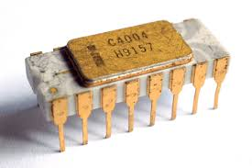
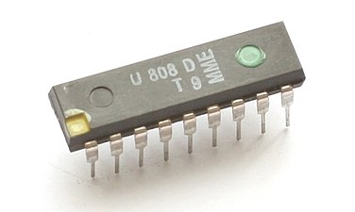
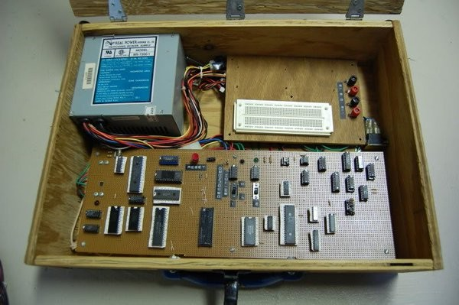
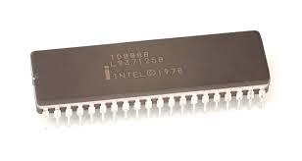
Intel 4004:
Release Date: 1971 Bit Width: 4-bit
Clock Speed: Up to 740 kHz Transistor Count: 2300
Intel 8008:
Release Date: 1972 Bit Width: 8-bit
Clock Speed: Up to 500 kHz Transistor Count: Approximately 3500
Intel 8080:
Release Date: 1974 Bit Width: 8-bit
Clock Speed: Up to 2 MHz Transistor Count: 6000
Intel 8085:
Release Date: 1976 Bit Width: 8-bit
Clock Speed: Up to 3 MHz Transistor Count: 6500
Intel 8086:
Release Date: 1978 Bit Width: 16-bit
Clock Speed: Up to 10 MHz Transistor Count: 29000
Intel 8088:
Release Date: 1979 Bit Width: 16-bit
Clock Speed: Up to 5 MHz Transistor Count: 29000

Slide 16

MD Am9080:
Release Date: Mid-1970s
Bit Width: 8-bit
Compatible Version with Intel 8080.
AMD Am2900:
Release Date: 1975
Bit Width: 4-bit (Separate processing units)
Used in complex applications.
AMD 386
Release Date: 1985 (But considered the end of the fourth generation)
Bit Width: 32-bit
Clock Speed: Ranges from 12 to 40 MHz.
Significant performance improvement compared to the fourth generation.

Slide 17
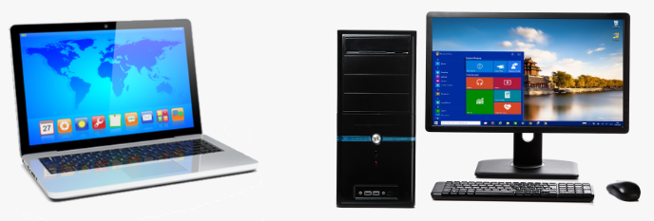
Fifth generation computers (1985 - now)
Features:
Durable, fast, and large storage capacities.
Portable computers that can operate for hours without electricity.
Use of Artificial Intelligence:
In applications like gaming, image processing, spell checking, and search engines.
Supports robots, self-driving cars, and navigation systems.
Operating Mechanism:
Utilizes ULSI technology with millions of transistors on a single chip.
Increased capacity and speed of RAM and hard drives.
Advantages:
Incorporates artificial intelligence, processes larger data volumes, smaller and lighter design, and faster than previous generations.

Slide 18

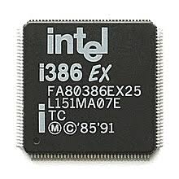
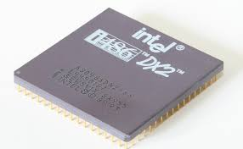
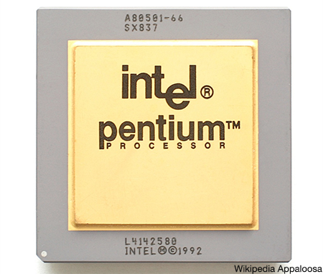
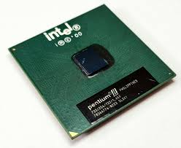
Intel 80386 (1985)
Intel 80486 (1989)
Intel Pentium (1993)
Intel Pentium III (1999)
Architecture: 32-bit
Clock Speed: 12-40 MHz
Maximum Memory Addressing: 4 GB
Notes: The first 32-bit processor from Intel, offering significantly better performance compared to previous generations.
Architecture: 32-bit
Clock Speed: 16-100 MHz
Maximum Memory Addressing: 4 GB
Notes: Integrated a Floating-Point Unit (FPU) within the processor, enhancing performance in scientific applications.
Architecture: 32-bit
Clock Speed: 60-300 MHz
Maximum Memory Addressing: 64 GB
Notes: Introduced Superscalar architecture, allowing multiple instructions to be executed simultaneously.
Architecture: 32-bit
Clock Speed: 450 MHz - 1.4 GHz
Maximum Memory Addressing: 4 GB
Notes: Improved processing performance and supported new technologies like SIMD.

Slide 19
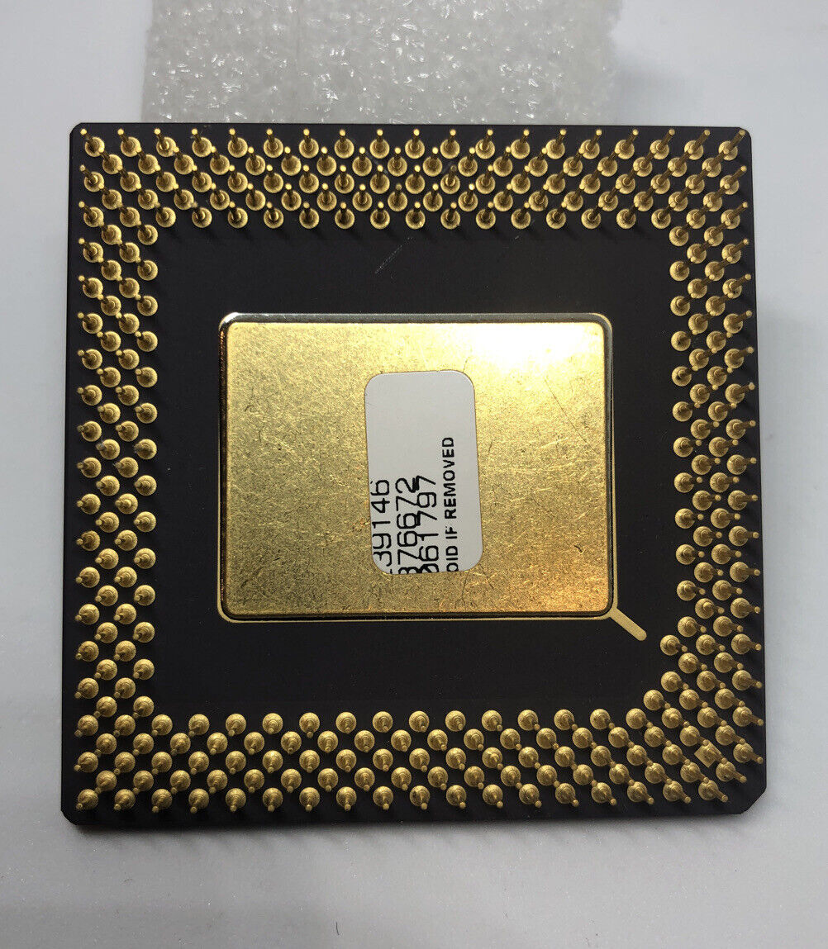
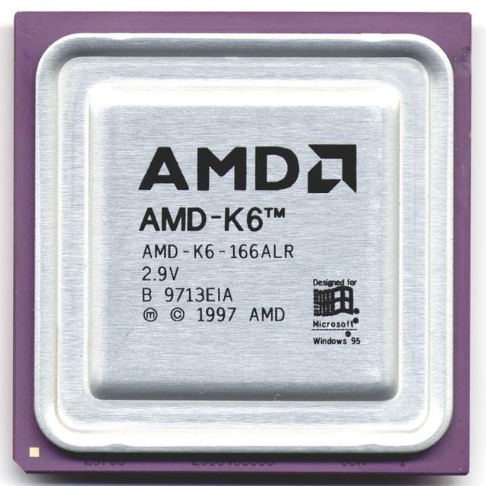
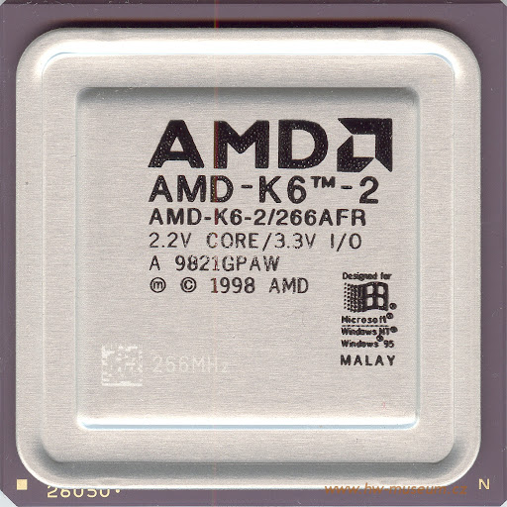
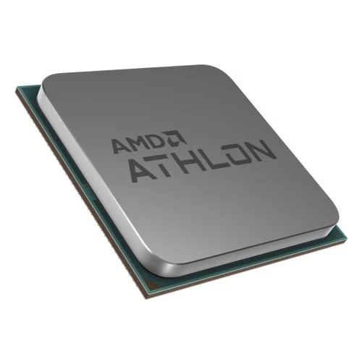
AMD K5 (1996): 32-bit architecture with a clock speed ranging from 75-166 MHz, it was a direct competitor to the Intel Pentium, providing good performance in gaming and office applications.
AMD K6 (1997): 32-bit architecture with a clock speed ranging from 166-550 MHz, it competed with the Intel Pentium II and became popular in-home computers.
AMD K6-2 (1998): 32-bit architecture with a clock speed ranging from 266-550 MHz, it introduced 3DNow! technology, enhancing graphics and gaming performance.
AMD Athlon (1999): 32-bit architecture (later 64-bit) with a clock speed ranging from 500 MHz - 1 GHz, it showed significant performance improvements compared to previous generations, marking the beginning of the high-performance processor era.

Slide 20
2000
2006
2007
Intel Pentium 4
Architecture: 32-bit
Clock Speed: 1.3 GHz - 3.8 GHz
Notes: Used Net Burst architecture technology and offered high performance in multitasking applications.
Intel Core Duo
Architecture: 32-bit / 64-bit
Clock Speed: 1.66 GHz - 2.33 GHz
Notes: Provided significant improvements in energy efficiency and processing performance compared to Pentium processors.
Intel Core 2 Quad
Architecture: 64-bit
Clock Speed: 2.4 GHz - 3.0 GHz
Notes: Intel's first quad-core processor, which significantly increased performance in multitasking and complex applications.
Intel Pentium D
Architecture: 64-bit
Clock Speed: 2.66 GHz - 3.73 GHz
Notes: Intel's first dual-core processor, which increased processing performance in heavy applications.
Intel Core 2 Duo
Architecture: 64-bit
Clock Speed: 1.8 GHz - 3.33 GHz
Notes: Featured 65nm manufacturing technology and delivered outstanding performance in data processing and gaming, making it one of the best processors of that time.
2005
2006

Slide 21
Since 2008, Intel has introduced the Core series of processors that have revolutionized the world of computing. It started with the Core i7 series, which offered superior performance thanks to Hyper-Threading technology, followed by the Core i5 as a balanced option. In 2017, the Core i9 was launched, targeted at power users with high performance and multiple cores. Subsequent generations, such as the 10th Gen Comet Lake and 11th Gen Rocket Lake, saw significant improvements in graphics and performance. The 12th Gen Alder Lake processors introduced a hybrid design that combined performance and efficiency cores, increasing power efficiency and multitasking performance, confirming Intel's market leadership.

Slide 22

2003
AMD Athlon 64
Architecture: 64-bit
Clock Speed: 1.8 GHz - 3.0 GHz
Notes: The first 64-bit processor for personal computers, it provided superior performance in heavy applications.
2017
AMD Ryzen
Architecture: 64-bit
Clock Speed: 3.0 GHz - 4.0 GHz (with Boost)
Notes: Revolutionized the processor market with excellent performance in gaming and multitasking applications, featuring Zen technology.
2019
AMD Ryzen 3000 Series
Architecture: 64-bit
Clock Speed: 3.5 GHz - 4.6 GHz
Notes: Utilized 7nm technology to improve performance and energy efficiency, with significant performance enhancements compared to previous generations.
2020
AMD Ryzen 5000 Series
Architecture: 64-bit
Clock Speed: 3.4 GHz - 4.9 GHz
Notes: Based on Zen 3 architecture, it delivered notable improvements in gaming and processing performance.

Slide 23

AMD Phenom (2007)
Processor architecture: 64-bit
Clock speed: 2.2 GHz - 3.0 GHz
Notes: Quad-core processor, support Hyper Transport technology, which increased processing performance.
AMD FX (2011)
Processor architecture: 64-bit
Clock Speed: 3.6 GHz - 4.7 GHz (with Turbo Boost)
Notes: Designed for high performance, with eight-core processors.

Slide 24

Tank you

